Slide 1
gWAS

Slide 2
GWAS risky variants
Risky missense variant conditioned on APOE4
NANOS1 is a Protein Coding gene. Diseases associated with NANOS1 include spermatogenic failure and atherosclerosis. Among its related pathways are Disease and PEDF Induced Signaling. GO annotations related to this gene include RNA binding and translation repressor activity.
Notes:
Initiated by NIH, ADSP is the first large-scale whole-genome sequencing project on AD.
Each person was diagnosed with one of four AD status: no AD, possible, probable, definite. The pie graph shows 10% of them are definite AD, another 63% and 14% are probable and possible AD, and 14% as no AD.

Slide 3
GWAS protective variants
Protective missense variant conditioned on APOE2
LRG1 (Leucine-Rich Alpha-2-Glycoprotein 1) is a Protein Coding gene. Diseases associated with LRG1 include normal pressure hydrocephalus.
Notes:
Initiated by NIH, ADSP is the first large-scale whole-genome sequencing project on AD.
Each person was diagnosed with one of four AD status: no AD, possible, probable, definite. The pie graph shows 10% of them are definite AD, another 63% and 14% are probable and possible AD, and 14% as no AD.

Slide 4
GWAS protective variants
Risky allele conditioned on APOE4
METTL14 (Methyltransferase Like 14) is a Protein Coding gene. Diseases associated with METTL14 include alcohol dependence.
Notes:
Initiated by NIH, ADSP is the first large-scale whole-genome sequencing project on AD.
Each person was diagnosed with one of four AD status: no AD, possible, probable, definite. The pie graph shows 10% of them are definite AD, another 63% and 14% are probable and possible AD, and 14% as no AD.

Slide 5
GWAS risky variants
Notes:
Initiated by NIH, ADSP is the first large-scale whole-genome sequencing project on AD.
Each person was diagnosed with one of four AD status: no AD, possible, probable, definite. The pie graph shows 10% of them are definite AD, another 63% and 14% are probable and possible AD, and 14% as no AD.

Slide 6
Alzheimer’s Disease Sequencing Project (ADSP)
Objective: Identify genomic variants that increase or decrease the risk of developing AD.
Until today, ADSP project has released the whole genome sequencing data for 584 people across 111 families.
AD diagnosis for 584 people across 111 families.
Age, Sex, and APOE genotype data were collected
Notes:
Initiated by NIH, ADSP is the first large-scale whole-genome sequencing project on AD.
Each person was diagnosed with one of four AD status: no AD, possible, probable, definite. The pie graph shows 10% of them are definite AD, another 63% and 14% are probable and possible AD, and 14% as no AD.

Slide 7
Age over AD status
Age generally increase with AD probability.
Notes:
The boxplot on the right shows the age distributions for people in each of the four AD categories. They are generally comparable, with a slight increase in the probable and definite categories.
Outliers: Q1 - 1.5 * IQR, Q3 + 1.5 * IQR

Slide 8
Sex over AD status
Female proportion increases with AD probability

Slide 9
APOE over AD status
APOE ε3ε4 proportion increases with AD probability
Notes:
APOE ε2 is rare and may protect against AD.
APOE ε3 is the most common allele and plays a neutral role.
APOE ε4 present in about 25 to 30% of population and in about 40 % of people with LOAD.

Slide 10
Genomic variants summary - complete
Notes:
With the whole-genome sequencing data from the 584 people, the first step of our work was to identify and quantify the genomic variants in each sample. We are currently focusing on SNP.

Slide 11
Ordered categorical models
A ordered categorical model is a model for an ordered categorical variable Y, that can fall in 1, 2, …, J categories.

Slide 12
Population structure
Genotype-based relatedness
Identical by state algorithm for kinship matrix

Slide 13
Kinship coefficients
Kinship coefficients of sample pairs within (In) and between (Out) families as recorded.

Slide 14
Kinship coefficients
Kinship coefficients by including autosome variants (1-22), and take-one-chromosome-out variants (no_chr**)

Slide 15
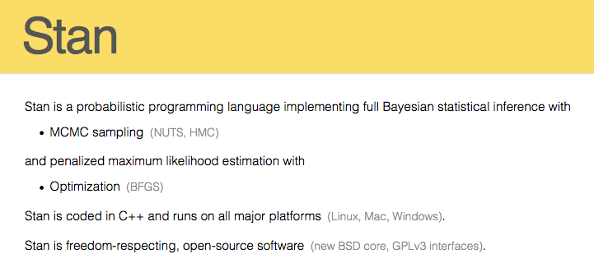
Estimation of ordered categorical mixed model

Slide 16
Model estimate on covariates
Point and bar are the first mode and 95% credible interval of covariant effect’s posterior distribution
Female, shows minor detrimental effect than Male
Effects of APOE genotypes concord with the literature

Slide 17
LOD Manhattan
Color represent risky (red) and protective (blue)effect. Size represents effect size.

Slide 18
LOD Manhattan: Linear mixed model
Color represent risky (red) and protective (blue)effect. Size represents effect size.

Slide 19
Models
GLM: Ordered categorical response, kinship correction, Stan
LMM: Linear response, kinship correction, QtlRel
LMER: Linear response, family correction, hierarchical model
CLMM: Ordered categorical response, family correction, hierarchical model

Slide 20
Models
GLM: Ordered categorical response, kinship correction, Stan
LMM: Linear response, kinship correction, QtlRel
LMER: Linear response, family correction, hierarchical model
CLMM: Ordered categorical response, family correction, hierarchical model

Slide 21
Models
Scatterplot on LOD
GLM: Ordered categorical response, kinship correction, Stan
LMM: Linear response, kinship correction, QtlRel

Slide 22
Top variants (0.001 LOD quantile)

Slide 23
Top variants (0.001 LOD quantile)

Slide 24
Top variants (0.001 LOD quantile)

Slide 25
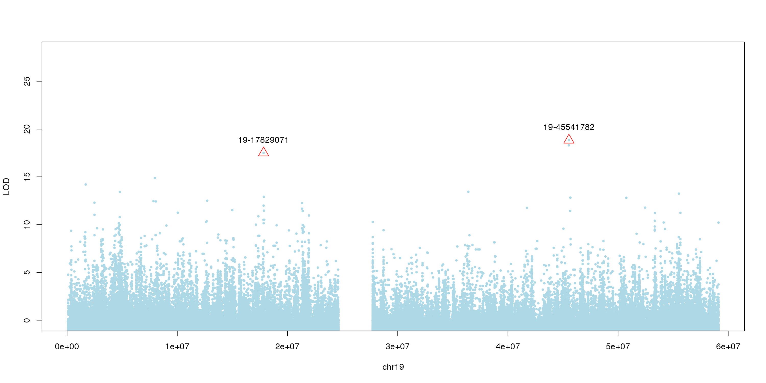
Peak-wise versus top quantile wise

Slide 26
Discussion
carterdev:3838/Adsp
Paper layout
Method
Additive model
Apoe2 epistasis
Apoe4 epistasis
Peak-wise versus top-quantile wise
Integrate with gene expression dataset on AD samples

Slide 27
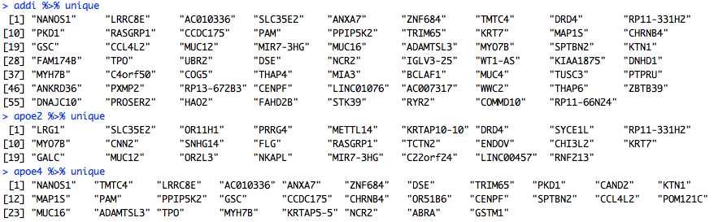
Candidate genes

Slide 28
Locus
Notes:
Some show significance.

Slide 29
Pipeline in a brief
Genotype
Phenotype
Extracting SNP calls from VCF (CS)
github/geno/myVcf.sh
Phenotype & metadata processing
github/pheno.R
AD status: 584 -> 578
Other dementia and unknown
Age: 578 -> 576 (Missing data)
Sex: 39% (M) / 61% (F)
APOE: 2, 3, 4
Extract complete variants and genotype data in R
github/geno/geno.R
Classify variants, make genotype matrix and meta data (bi-variants only) github/geno/geno.R:meta.R
Compute kinship matrix on complete bi-variants
github/geno/plink.sh:tfam.R:kinship.sh
Predict variants effects (bi-variant: MAF > 0.01)
github/geno/vep.R:vep.sh
MODELS: Generalized linear mixed model
ordered categorical with genotype-based relatedness correction
github/GLM/*

Slide 30
Predicted effects of genomic variants
Notes:
With the whole-genome sequencing data from the 584 people, the first step of our work was to identify and quantify the genomic variants in each sample. We are currently focusing on SNP.

Slide 31
LOD Manhattan
Color represent risky (red) and protective (blue)effect. Size represents effect size.
Code APOE as factor: 33, 22, 23, 24, 34

Slide 32
Genomic variants summary – SNP
Notes:
With the whole-genome sequencing data from the 584 people, the first step of our work was to identify and quantify the genomic variants in each sample. We are currently focusing on SNP.

